Slide 1

Migration From PCF to AWS

Slide 2

Application name- Exhibit maker
Functionality
Access needed
Possible migration options
AWS Lambda- Again a process has to run for per cycle basis and the time for loading can exceed 20 min, especially when accessing the cession service
OCP – Migration to OCP is good option as Travelers has already set up OCP on AWS
Redis
Rabbit MQ
S3
Teradata ware house
Reads data from Teradata and prepares report.

Slide 3
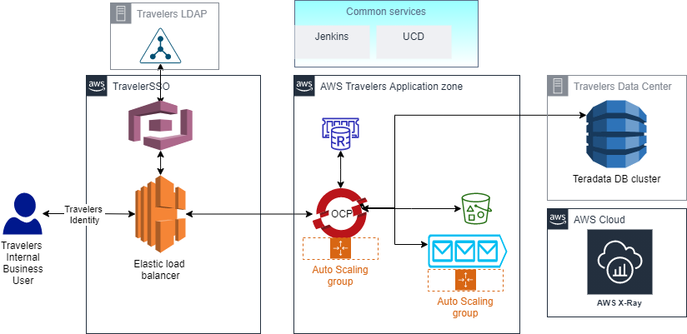
Conceptual architecture
The Architecture assumes that the RabbitMQ is available in hardware or on a container
Elastic Cache for Redis can will be used
Access to on prem database should be available
Existing Jenkins and UCD will be used. Necessary deployment script changes shall be made
Access to ReBar container building framework is provided to us.
Logs are drained to AWS X-Ray using from OCP.

Slide 4
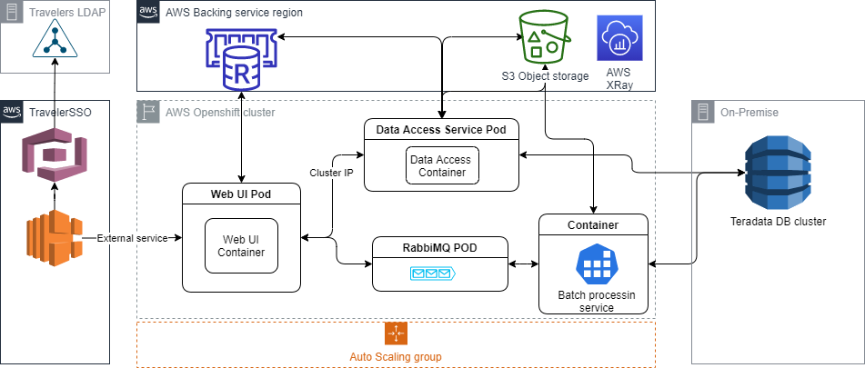
Application Architecture
The Architecture assumes that the RabbitMQ is available on a container
Elastic Cache for Redis can will be used for caching
Access to on prem database should be available
Access to ReBar container building framework is provided to us.
Logs are drained to AWS X-Ray using from OCP.

Slide 5
Execution Plan And Resource Plan
Execution Plan
Resource plan
Total number of Resource 2
Span of MVP – 2 weeks
Points per sprint - 6
MVP0
MVP2 – migrate Exhibit maker data access service
MVP3 – migrate UI and SA validation and PIPS transition
MVP1 – migrate Exhibit maker batch service
Test our assumptions and ensure entry criteria is fulfilled
Any additional POC needed based on architectural suggestion

Slide 6
Estimates
To be filled by Santhosh

Slide 7
Application name- EPCR Auto Quote
Functionality
Access needed
Redis
On Prem SQL server or SQL server on AWS but data should be loaded into this instance
Expose Cession service to the cloud AWS end point
SMTP service
Possible migration options
AWS Lambda- Again a process has to run for per cycle basis and the time for loading can exceed 20 min, especially when accessing the cession service
OCP – Travelers has already set up OCP on AWS and hence migration from PCF to OCP will be in line with Travelers road map
Load the Transfusion data from staging table to transfusion tables

Slide 8
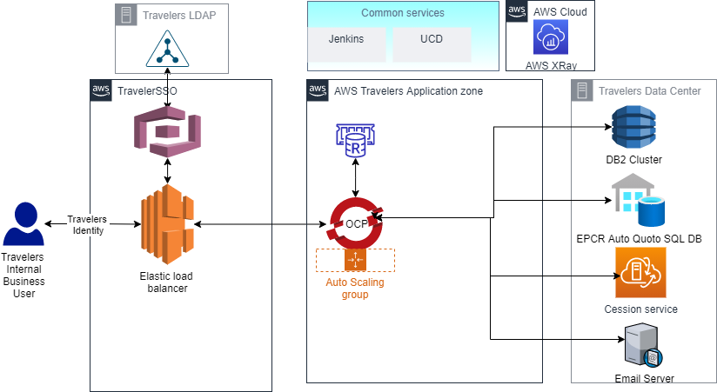
Conceptual architecture - EPCR Auto Quote
Elastic Cache for Redis can will be used
Access to on prem database should be available for DB2 and SQL server and Cession service
Existing Jenkins and UCD will be used. Necessary deployment script changes shall be made
Access to ReBar container building framework is provided to us.
Logs are drained to AWS X-Ray using from OCP.

Slide 9
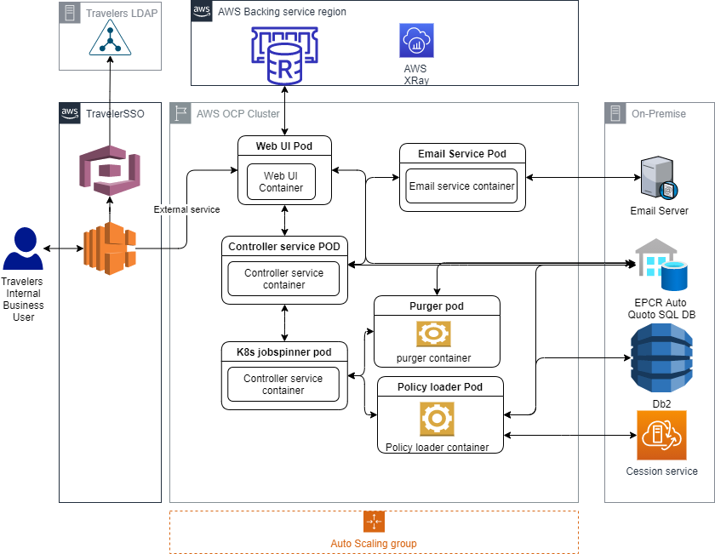
Application Architecture – EPCR Auto Quote
Access to on prem database should be available for DB2 and SQL server and Cession service
Existing Jenkins and UCD will be used. Necessary deployment script changes shall be made
Access to ReBar container building framework is provided to us.
Logs are drained to AWS X-Ray using from OCP.
This application uses a K8s job spinner which wraps K8s job sdk. It launches K8s job on demand. For this a Service principle capable of creating the job is required

Slide 10
Execution Plan And Resource Plan
Execution Plan
Resource plan
Total number of Resource 4
Span of MVP – 2 weeks
Points per sprint - 6
MVP0
MVP2 – Service Migration 2
MVP3 – migrate UI and Service
MVP1 – Service Migration 1
Test our assumptions and ensure entry criteria is fulfilled
Solution setup
KT to team if any
Migrate EPCR Email service
Migrate Perf service
K8s job spinner service creation
Class library modification to call k8s job spinner
Migrate web UI
Migrate Controller service
MVP4 – Job migration
Migrate Policy loader
Migrate Purger
MVP 5 – Deployment and PIPS KT

Slide 11
Estimates
To be filled by Santhosh

Slide 12
Ask from Travelers
OCP is chosen as per Tarvelers enterprise strategu.
For OCP, access to ReBar container building tool, Container registry, Access to EKS is required
Access to Travelers Container registry is required
Approval and Setup for Redis and Rabbit MQ in AWS. If we must move out of these backing services, then additional effort will be involved.
POC with all the above items

Slide 13

Next Steps
Approval to our Migration options
MVP Plan and Estimation from Dev Side to be approved
story creation post to approvals

